Slide 1
Module 6
IP Unicast
Routing and Configuration
Notes:
In this Module, we will be discussing Layer 3 Unicast Routing Fundamentals, primarily the IP Forwarding and IP Routing functionality and configuration.
The students are expected to have a solid understanding of Layer 3, Routing fundamentals.
This module will also describe the CLI commands to configure IP routing on the switch.

Slide 2
Module Objectives
Describe Layer-3 Operations and differentiate between IP Forwarding and Routing Function
Discuss ExtremeWare Supported IP features
Define RIF, IP Route Table and IPFDB
Describe how to populate entries in the IPFDB and IP Route Table
Learn how to configure IP Unicast Routing
Perform Lab Exercise
Summary
Notes:
Upon successful completion of this Module, the student participants will be able to achieve the above listed objectives at the end of this five day course.
We assume that the student is already familiar with IP unicast routing.

Slide 3
Layer 3 Operations
In Layer 2 environment, VLANs (Broadcast Domains) are:
  Distinct and separate
  Devices in different VLANs cannot communicate with each other
Layer 3 functionality
  Allows data to cross boundaries created by VLANs
  Enable devices in different subnets to exchange information
Notes:
Recall the functions of the OSI-ISO 7-Layer model, particularly the Data Link Layer – Layer 2 and the Network Layer – Layer 3.
In a Layer 2 environment, broadcast domains are distinct and separate.
Devices residing in separate broadcast domains cannot communicate. These devices do not have a common broadcast domain in order to communicate.
It is the Layer 3 functionality that allows data to cross the boundaries created by the broadcast domains. This enables devices in different subnets (broadcast domains) to exchange information.

Slide 4
Forwarding vs. Routing Function
Within a single switch, communication across the boundary of two or more directly connected networks, is enabled through the Forwarding Function.
Between switches across an enterprise, packets are moved over multiple boundaries through the assistance of a Routing Function.
Notes:
In a Layer-2 environment, broadcast domains are distinct and separate.
Network devices that reside in separate broadcast domains cannot communicate. (They do not share common broadcast domains).
It is the Layer-3 functionality that allows data to cross the boundaries created by broadcast domains, enabling devices in different subnets to exchange information.
Within a single switch, communication across the boundary of two or more directly connected networks (I.e. 2 or more broadcast domains/VLANs) is enabled through a Forwarding Function.
Between switches across an enterprise, packets are moved over multiple boundaries through a Routing Function.

Slide 5
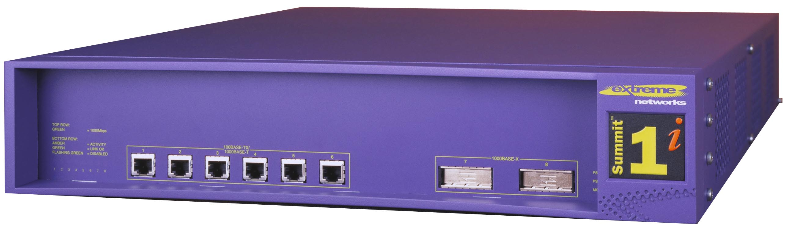

Layer-2 Operations Review
10.0.0.0/24
Host A
Host B
Notes:
How do two devices talk to each other in Layer 2?
This diagram will be use to emphasize devices communicating in Layer 2 via the MAC Address.
Even when using IP, end-stations resolve the Layer 3 destination address to the destination MAC address with ARP.
Here you can talk about the ARP basics.
When the switch sees the destination MAC address that is not itself - the switch knows that this is a Layer2 function and therefore, the switch will act as a layer2 bridge and so will do Layer 2 forwarding and do a lookup on the FDB. When the switch sees the destination MAC address as its own, it knows to perform Layer-3 function.

Slide 6
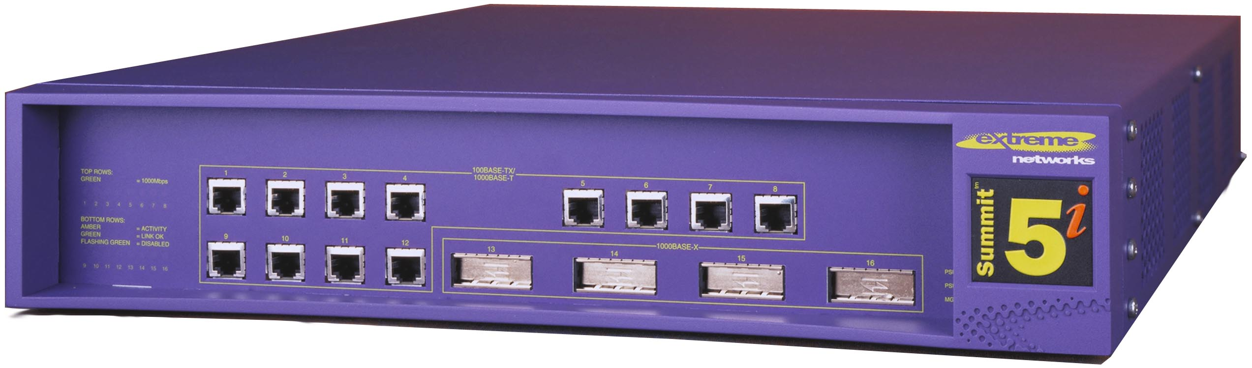
Layer-2 Operations
IP Forwarding Function
10.0.0.0/24
30.0.0.0/24
Host A
Host C
Host B
Notes:
This diagram will be use to emphasize the difference between routing and forwarding prior to discussing a routing protocol - I.e. RIP.
As discussed earlier recall that within a single switch, communication across the boundary of two or more directly connected networks, is enabled through the Forwarding Function.
Layer 2 is MAC source-based.
Layer 3 on the other hand, upon receipt of a packet, the switch knows what route it is on, otherwise, it knows to automatically send it to a default gateway for unknown destinations.
It is important to differentiate between the term IP Routing and IP Forwarding.
The DIAGRAM describes the following:
When a host in one broadcast domain (BLUE-VLAN) wants to talk to the device in a different broadcast domain (GREEN VLAN), it will ARP for the nearest gateway. Host A wants to communicate with Host C. Because the destination is the MAC address of the switch, the switch KNOWS it is a Layer 3 function.
The only way to talk to the switch is to make a Layer-3 decision. Tracing it in the diagram, the first conversion is from Layer 2 to a Layer 3. Because it is across VLANs, the endstation will ARP for the gateway.
Emphasize what happens as you move through the arrow. Conversion happens, L2-L3-L2-L3 and so on. We only make IP forwarding based on the destination IP address.

Slide 7
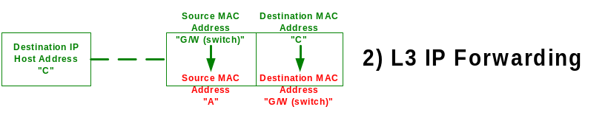
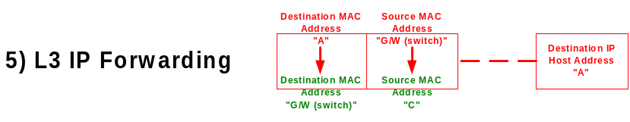
Layer-2 Operations
IP Forwarding Function
10.0.0.0/24
30.0.0.0/24
Host A
Host C
Host B
Notes:
This diagram will be use to emphasize the difference between routing and forwarding prior to discussing a routing protocol - I.e. RIP.
Layer 2 is MAC source-based.
Layer 3 on the other hand, upon receipt of a packet knows what route it is on, otherwise, it knows to send it to a default gateway.
It is important to differentiate between the term IP Routing and IP Forwarding. So given the example depicted above:
When a host in one broadcast domain (Red) wants to talk to the device in a different broadcast domain (green), it will ARP for the nearest gateway. Host A wants to communicate with Host C. Because the destination is the MAC address of the switch, the switch KNOWS it is a Layer 3 function.
The only way to talk to the switch is to make a Layer-3 decision. Tracing it in the diagram, the first conversion is from Layer 2 to a Layer 3. Because it is across VLANs, the endstation will ARP for the gateway.
Emphasis is on what happens as you move through the arrow. Conversion happens, L2-L3-L2-L3 and so on. We only make IP forwarding based on the destination IP address.

Slide 8
Layer 3 Operations - IP Routing Spanning Multiple Switches
40.0.0.0/24
Host E
Host D
S₁
30.0.0.0/24
10.0.0.0/24
Host A
S₂
Host C
Host B
Notes:
Let us add another switch in the previous example. How do we get from A to D? Is this different than when A communicated with C? The answer is No. The function of forwarding is identical.
The IP-protocol’s job is to facilitate communication between devices in different broadcast domains (VLANs).
The routing function works at layer-3. It is not complex at all. The switch L3-routing function creates a table that tells the router where to forward the packets. This routing table is simply a collection of all known networks and the local interface used to reach them. It is used for a lookup to match the destination address to a network.
All the routing function of the switch does is facilitate the forwarding decision. It does not move the data. Layer 2 is the one function capable of moving packets between devices.
So when it is time to do a lookup of an unknown IP destination host address, the protocol’s job is to learn the route to take by comparing the destination address to the list of networks in the routing table.
Again, for this diagram, remember the Route Table was used. This is still not the routing function in our switch yet!

Slide 9
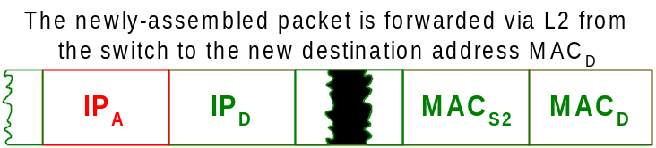

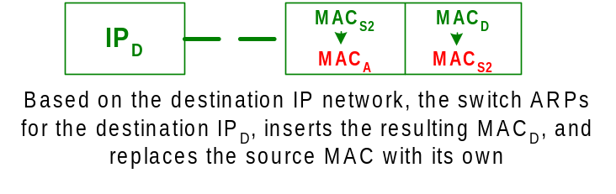

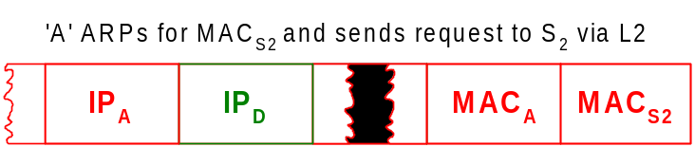
Layer 3 Operations - IP Routing
Spanning Multiple Switches cont…
40.0.0.0/24
Host E
Host D
S₁
30.0.0.0/24
10.0.0.0/24
Host A
S₂
Host C
Host B

Slide 10
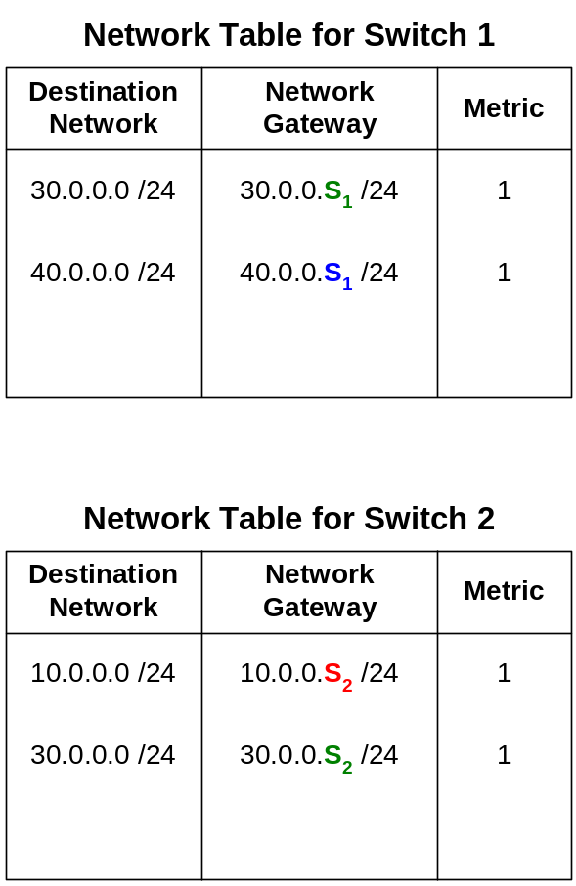
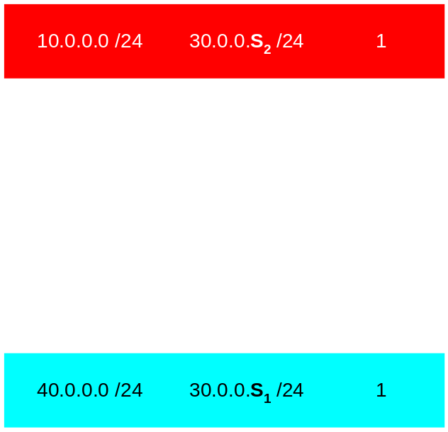
Layer 3 Operations - IP Routing
Spanning Multiple Switches cont…
40.0.0.0/24
Host E
Host D
S₁
30.0.0.0/24
10.0.0.0/24
Host A
S₂
Host C
Host B
Notes:
Given the scenario shown above, Host (E) cannot be seen by Switch1. In this case, you need to perform a static route configuration.

Slide 11
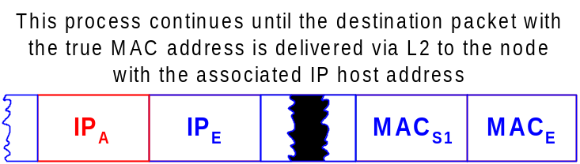

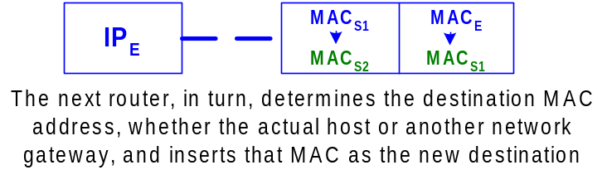

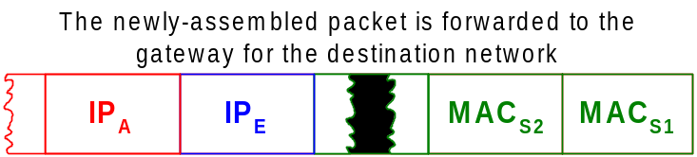

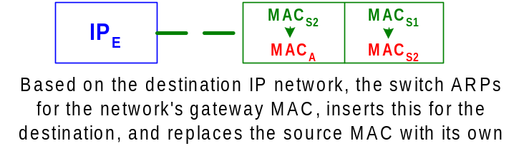
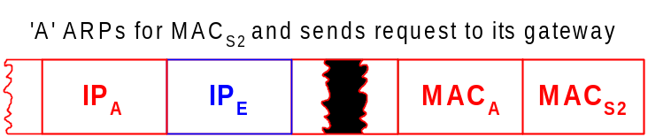

Layer 3 Operations - IP Routing
Spanning Multiple Switches cont…
40.0.0.0/24
Host E
Host D
S₁
30.0.0.0/24
10.0.0.0/24
Host A
S₂
Host C
Host B
Notes:
Starting from the bottom frame, you can analyze what happens as the switch receives the packet from Host A destined for Host E.

Slide 12
How Routing Is Accomplished
IP Forwarding function is disabled by default on the switch.
  If IP forwarding function is disabled, the IP Routing function is also disabled.
The switch will not be able to route until…
  IP Forwarding is enabled
  The VLAN is configured and assigned with an IP Address
  The VLAN is configured with a routing protocol
  The routing protocol is enabled globally on the switch

Slide 13
CLI Command - enable/disable ipforwarding
enable ipforwarding {vlan <name>}
disable ipforwarding {vlan <name>}
  Enables/disables IP routing for one or more VLANs. If no argument is provided, enables routing for all VLANs that have been configured with an IP address.
  The default setting for ipforwarding is disabled.
Notes:
This CLI command is not for Layer-2 environment, only Layer-3.
A classic error that occurs in IP Routing is when one starts configuring VLANs. After building the VLANs, one expects that this dynamic software is now ready to go. Then all of a sudden, when you expected the software to be able to route - IT DOES NOT ROUTE. Why?
Because IP Forwarding is not enabled on the VLANs created.
You need to enable IP Forwarding on every newly created VLANs.
Remember - Enable IP Forwarding for existing Interfaces and for every VLAN created.
NOTE:
Normally this can be a configured command, but for IP Forwarding this is not. Do not be confused with this. What this says, when enabled, is that this particular vlan can forward packets.

Slide 14
Components of Forwarding Function
The Extreme Forwarding function has two components:
  1- For unknown destinations, forwarding decisions are made by the CPU.
  2- For learned host addresses, layer-3 switching performs hardware lookups of a host route table and makes forwarding decisions based on the results.
Extreme switches forward IP at Line rate on all ports all the time
Notes:
When a router knows where to route, it functions virtually the same as what is done in Layer-2 with the MAC addresses.
The Extreme family of enterprise LAN switches delivers both Layer 3 and Layer 2 switching. Layer 3 switching is essentially very fast routing. Extreme is able to route IP traffic at wire speed on all switch ports. This is true routing that utilizes industry-standard routing protocols.
Because they perform true routing, Extreme switches operate with existing legacy routers on your network. As a result, the network manager can configure large meshed topologies that offer increased fault tolerance and redundancy.
Very large networks can be built by combining wire-speed Layer 3 and Layer 2 switching, enabling a logical partitioning of users and groups on top of a high-performance switched infrastructure. The current generation of Extreme switches supports up to 32,000 end stations.
“Wire-speed IP routing enables you to route where you can and only switch where you must” - i.e. you can select Layer 3 functions wherever possible and only use Layer 2 functionality where L3 won’t work (non-routing protocol support). We can use the robustness and redundancy of Layer 3 rather than having to rely on Layer 2.

Slide 15


Router Interface - (RIF)
Simply a VLAN configured with an IP Address
B
C
Router Interface
A
D
Network: 192.206.35.0/24
VLAN Green : 192.206.35.1/24
Network: 192.207.36.0/24
VLAN Red: 192.207.36.1 /24
Notes:
The L3 software and hardware function forwards IP traffic between router interfaces or VLANs.
In order to participate in L3, a VLAN must have an IP address assigned to it.
Also, you need to enable IP Forwarding on the VLAN so the switch can recognize that it is a Layer 3 function.
As you create VLANs with IP addresses belonging to different IP subnets, you can also choose to forward between the VLANs. Both the MAC switching and IP forwarding function occur within the switch (meaning both L2 and L3 functions occur within the switch).
Each IP address and mask assigned to the VLAN must represent a unique IP subnet. You cannot configure the same IP subnet on different VLANs.
The example above depicts a Summit4 with two VLANs defined: Green and Red. Ports 1 and 3 are assigned to Green; ports 15 and 16 are assigned to Red. Green belongs to network 192.206.35.0 and the router interface (VLAN) Green is assigned the IP address of 192.206.35.1. Red belongs to the IP network 192.207.36.0 and the router interface (VLAN) Red is assigned the IP address of 192.207.36.1. Traffic between the two VLANs is forwarded based on the configured network (IP address and mask).

Slide 16
The IP Forwarding/Routing Hierarchy
IP Forwarding Database – IPFDB
  ASIC look-up Host Table containing IP host routes and its outbound VLAN interface and port
  It can hold 32K IP host routes ⬅ CHECK WITH TJ
  Populated only by the CPU
IP Route Table
  Maintained by the CPU
  Used by the CPU to make forwarding decisions for unknown IP host addresses (address not found in the IPFDB)
  Holds up to 1024 static routes
  CPU handles routing table maintenance
Notes:
The switch uses several tables to determine the destination on where a packet received should be destined – in Layer 2, there is the FDB which we have learned in Module 3. There is also the IPARP table that is used to cache the mapping of MAC addresses and IP addresses the switch has been able to reach (e.g. with a PING, etc.)
The CLI command SHOW IPARP will display the IP Address Resolution Protocol (ARP) Table. You can filter the display by IP address, VLAN or permanent entries.
When the destination is unknown, the switch uses the above hierarchy to do IP forwarding and/or IP routing.
IPFDB
IP Route Table

Slide 17
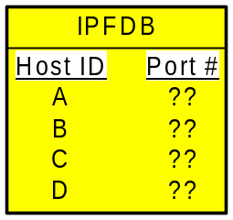
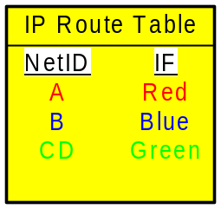
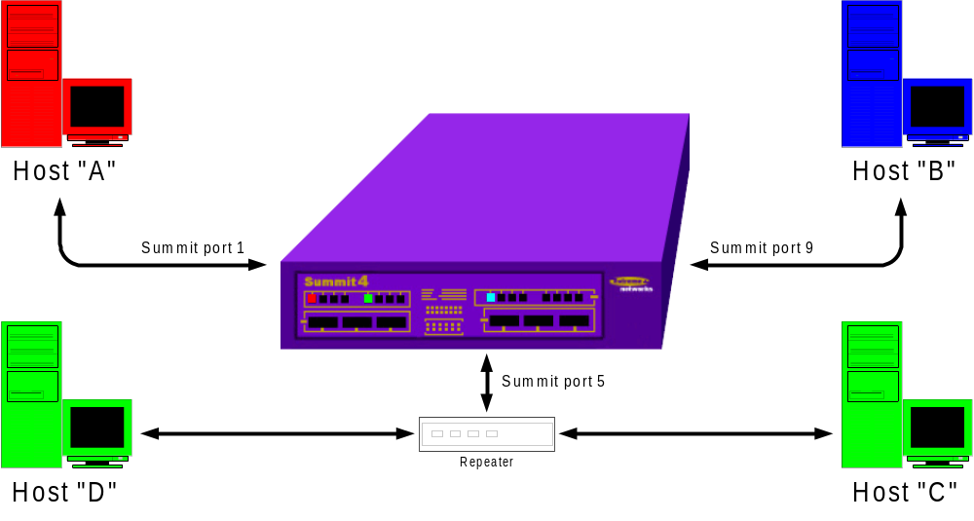






Populating the IPFDB
In a newly configured network, “D” initiates communication with “B” in another subnet by sending the request to its gateway.
Since the switch knows what port it just forwarded the packet onto, the destination IP address can be added to the IPFDB
The destination IP address is compared to the table of known routes and the datagram is forwarded onto the correct interface
Because the destination is unknown, the packet is escalated to the CPU for resolution.
At the same time, the CPU extracts the source IP address and adds it to the IP forwarding database
Notes:
In this scenario, Host D wants to talk to Host B, and Host B is reachable via the switch.
When the destination MAC address is the switch, then it is determined that it is being asked to perform a layer-3 function.
The ASIC tries to match the destination IP host address of the packet with the IPFDB. The ASIC uses the IPFDB for lookups, and only the CPU uses the routing table for lookup.
When the ASIC finds that there is no match in the IPFDB, the packet is passed up to the CPU. This is what happens: D wants to talk to B - Look at IP forwarding database because the MAC address is the switch, at the lookup, it is not on the table (dest IP of B) and send it to the CPU.
At this point the CPU does three things:
The CPU matches the destination IP address with the IP route table and forwards out the associated interface.
It puts the IP host address into the IPFDB as a host entry and then,
It checks the source IP host address and adds it to the IPFDB.
Remember, the IPFDB is populated with Layer-3 information. With the switch Layer-3 functionality, we learn the source and destination in one pass.

Slide 18
Displaying IPFDB
CLI Command – show IPFDB
show ipfdb { vlan <vlan name> | <ip address> }
  Displays the hosts entries that have been transmitting or receiving packets, and the port and VLAN for each host entry.
* Summit1i:32 # show ipfdb
Dest IP Addr TblIdx MacIdx Flag FlowInfo MAC Address VLAN Port
10.101.0.1 0F64.0 1393.0 0000 00:e0:2b:04:da:00 0001 0022
* Summit1i:33 #
Notes:
Here you see Destination (HOST ID) IP address and VLAN (shown is default VLAN) and the port.

Slide 19
Types of IP Route Table Entries
Directly-connected networks
  When configured will always be in the IP route table
Dynamic route entries
Permanent route entries
  Default routes
  Static routes
  Blackhole routes
Notes:
The switch maintains an IP routing table for both network and host routes. The table is populated either dynamically or statically.
The above lists the types of IP route table entries.
Permanent routes are statically configured routes and can be categorized further into three:
Default
If you define a default route, and subsequently delete the VLAN on the subnet associated with the default route, the invalid default route entry remains. You must manually delete the configured default route.
Static
Blackhole

Slide 20
Dynamic Route Entries
Reachable routes learned via RIP, OSPF or BGP
Holds learned routes based on the protocol:
  RIP - 8,000
  OSPF - 30,000 (Summit1i, 5i, 48i) 100,000 (BlackDiamond, Alpine and Summit 7i)
  BGP - 250,000 (Summit1i, 5i, 48i) or 1,000,000 (BlackDiamond, Alpine and Summit 7i)
Are aged out when an update is not received for a period of time based on the routing protocol

Slide 21
Permanent Routes
Static Routes
Manually entered into the routing table
Must be associated with a valid IP subnet
Used to reach networks not advertised by routers
Can be advertised using the CLI command:
  [enable | disable] rip export static
  [enable | disable] ospf export static
Maximum 1024 static unicast routes on the switch
Also used for security reasons
Never aged out of the routing table
Notes:
Static routes are manually entered into the routing table. They are used to reach networks not advertised by routers. You can configure up to 64 static unicast routes on the switch.
Static routes can also be used for security reasons, to control which routes you want advertised by the router. You can decide if you want all static routes to be advertised using the commands:
[enable | disable] rip export static
[enable | disable] ospf export static
A static route must be associated with a valid IP subnet. An IP subnet is associated with a single VLAN by its IP address and subnet mask. If the VLAN is subsequently deleted, the static route entries using that subnet must be deleted manually.

Slide 22
Permanent Routes
Blackhole Routes
Configured as an entry in the IP Route table with a specified IP destination address
  When a packet is received with a matching destination address, the packet will be disregarded.
Used as a security measure
  Also used in special circumstances where a specific destination address must be discarded
Are treated like permanent entries
  In the event of a switch reset or power off/on cycle
Are never aged out of the routing table.
Notes:
You can also configure blackhole routes - traffic to these destinations is silently dropped.

Slide 23
Multiple Routes in the IP Route Table
May be used for redundancy
A routing protocol will only use routes with shortest metric
Switch picks the route with the longest matching network mask
  If they are still equal, it picks the route using the following criteria (in the order specified)
  1 - Directly attached network interfaces
  2 - ICMP redirects
  3 - Static Routes
  4 - Directly attached Network interfaces that are not active
Notes:
When there are multiple, conflicting choices of a route to a particular destination, the router picks the route with the longest matching network mask. If these are still equal, the router picks the route using the following criteria (in the order specified):
Directly attached network interfaces
ICMP redirects
Static routes
Directly attached network interfaces that are not active.
NOTE: If you define multiple default routes, the route that has the lowest metric is used. If there are multiple default routes that have the same lowest metric, the system picks one of the routes.

Slide 24
Relative Route Priorities
Route Origin | Route Priority
Direct | 10
Black Hole | 50
Static | 1100
ICMP | 1200
OSPFIntra | 2200
OSPFInter | 2300
RIP | 2400
OSPFExtern1 | 3200
OSPFExtern2 | 3300
BOOTP | 5000
Notes:
The table above lists the relative priorities assigned to routes depending upon the learned source of the route. Directly-connected networks will always get the highest priority.
Although these priorities can be changed, do not attempt any manipulation unless you are expertly familiar with the possible consequences.
If you must change the route priority – the CLI command is in the next slide.

Slide 25
CLI Command - config iproute priority
config iproute priority [ bootp | e-bgp | i-bgp | icmp | ospf-extern1 | ospf-extern2 | ospf-inter | ospf-intra | rip | static ] <priority>
  Changes the priority for all routes from a particular route origin.
  NOTE: Do not attempt any manipulation unless you are expertly familiar with the possible consequences.
Notes:
To reiterate: although these priorities can be changed, do not attempt any manipulation unless you are expertly familiar with the possible consequences.

Slide 26
Multiple Routes
IP Route Sharing
Allows multiple equal-cost routes to be used concurrently
It can be used with static routes or with OSPF routes
  In OSPF - this is called ECMP - Equal Cost Multi-Path
Disabled by default on the switch
To enable it, use the CLI command:
  enable iproute sharing
Notes:
Some protocols may only use one route even when multiple routes of the same metric exist, however note below.
IP route sharing allows multiple equal-cost routes to be used concurrently. IP route sharing can be used with static routes or with OSPF routes. In OSPF, this capability is referred to as equal cost multi-path (ECMP) routing.
To use IP route sharing,
First enable it. (because it is disabled by default)
Next, configure static routes and/or OSPF as you would normally.
As many as five ECMP routes can be used for a given destination.
Route sharing is useful only in instances where you are constrained for bandwidth. This is typically not the case using Extreme switches. Using route sharing makes router troubleshooting more difficult because of the complexity in predicting the path over which the traffic will travel.

Slide 27
Displaying IP Route Table
CLI Command – show iproute
show iproute
{ origin [ bgp | blackhole | direct | e-bgp | i-bgp | ospf-extern1 | ospf-extern2 | ospf-inter | ospf-intra | rip] | permanent | priority | route-map | sorted | summary | vlan <vlan_name> | <ip address> }
  Displays the contents of the IP Route Table or the route origin priority.
Notes:
The IP route table entries can be examined by issuing the CLI command “show iproute”
The IP Route Table display will have the following:
OR Destination Gateway Mtr Flags Use M-Use VLAN Acct-
* table of routes *
Origin(OR): b - BlackHole, bg - BGP, be - EBGP, bi - IBGP, bo - BOOTP, ct - CBT
d - Direct, df - DownIF, dv - DVMRP, h - Hardcoded, i - ICMP
mo - MOSPF, o - OSPF, oa - OSPFIntra, or - OSPFInter, oe - OSPFAsExt
o1 - OSPFExt1, o2 - OSPFExt2, pd - PIM-DM, ps - PIM-SM, r - RIP
ra - RtAdvrt, s - Static, sv - SLB_VIP, un - UnKnown.
Flags: U - Up, G - Gateway, H - Host Route, D - Dynamic, R - Modified,
S - Static, B - BlackHole, u - Unicast, m - Multicast.
Total number of routes.
Mask distribution:
Route origin distribution:

Slide 28
Other IP Unicast Features
Proxy ARP
IP Multinetting
DHCP/BOOTP relay
UDP Forwarding
VLAN Aggregation ⬅
Notes:
Proxy ARP - Proxy Address Resolution Protocol
Allows ARP-capable devices to respond to ARP Request packets on behalf of ARP-incapable devices.
Also used to achieve router redundancy
Used to simplify IP client configuration which is supported by the switch
Up to 64 proxy ARP entries can be configured
IP Multinetting
In many legacy IP networks, there is a need to overlap multiple subnets into one physical port with third-party devices that do not support tagging.
In normal operation, you can only assign a port untagged once to a router interface.
IP multinetting allows untagged assignment of multiple VLANs to the same physical port. CLI command to enables/disables IP multinetting on the system: [enable | disable] multinetting
UDP Forwarding
A flexible and generalized routing utility
Used for handling the directed forwarding of broadcast UDP packets
Allows applications to be directed to different DHCP servers
An example application are multiple DHCP relay services from differing sets of VLANs

Slide 29
Configuring IP Unicast Routing
1 - Create and configure two or more VLANs
  create vlan <vlan_name>
  config <vlan_name> add ports <portlist>
2 - Enable IP forwarding for one or all VLANs
  config <vlan_name> ipaddress <ipaddress/netmask>
3 - Enable IP forwarding for one or all VLANs
  enable ipforwarding
4 - Add IPF-enabled VLANs to routing protocol
  config <routing_protocol> add <vlan_name>
5 - Enable routing protocol (RIP or OSPF)
  enable <routing_protocol>
Notes:
This will describe the commands associated with configuring IP unicast routing on the switch. Configuring routing involves the following steps:
Number one is very crucial: 1 - Create and configure two or more VLANs
You need 2 VLANs at least because what if you have only one interface, where can it go?
1- Create and configure two or more VLANs
Although it is possible to enable IP forwarding and an IP routing protocol (such as RIP) with only one VLAN defined, the switch does not create or respond appropriately to ICMP messages unless at least two VLANs are created and configured.
2- Assign an IP address to each VLAN that will be using routing.
Ensure that each VLAN has a unique IP address.
3- Enable IP forwarding for one or all VLANs
4- Add IPF-enabled VLANs to routing protocol
5- Enable routing protocol ( RIP or OSPF )

Slide 30
IP Routing CLI Commands
To add static entries in the ip route table
  config iproute add/delete <ip addr>
  config iproute add/delete default
  config iproute add/delete blackhole
To clear entries in the IPARP and IPFDB entries
  clear iparp
  clear ipfdb
To enable
  enable irdp/disable icmp unreachables
Notes:
More IP routing commands is presented above.
config iproute add/del <ipaddress> <mask> <gateway> {<metric>}
Adds/deletes a static address to the routing table. Use a value of 255.255.255.255 for mask to indicate a host entry.
config iproute add/del default <gateway> {<metric>
Adds a default gateway to the routing table. A default gateway must be located on a configured IP interface. If no metric is specified, the default metric of 1 is used.
config iproute add/del blackhole <ipaddress> <mask>
Adds/deletes a blackhole address to the routing table. All traffic destined for the configured IP address is dropped, and no Internet Control Message Protocol (ICMP) message is generated.
clear iparp [<ipaddress> <mask> | vlan <name>]
Removes dynamic entries in the IP ARP table. Permanent IP ARP entries are not affected.
clear ipfdb [<ipaddress> | vlan <name>]
Removes the dynamic entries in the IP forwarding database.
enable irdp {vlan <name>}
Enables the generation of ICMP router advertisement messages on one or more VLANs.
The default setting is enabled.
disable icmp unreachables {vlan <name>}
Disables the generation of ICMP unreachable messages on one or more VLANs.

Slide 31
Verifying IP Routing Configuration
show ipconfig
  show ipconfig {detail vlan <vlan name>}
    Displays configuration information for one or more VLANs
show ipfdb
show iproute
show ipstats
show iparp
Notes:
Use the CLI command show iproute command to display the current configuration of IP unicast routing for the switch, and for each VLAN. This command displays the currently configured routes, and includes how each route was learned.
Additional verification commands include the following:
show iparp - Displays the IP ARP table of the system
show ipfdb - Displays the hosts that have been transmitting or receiving packets, and the port and VLAN for each host.
Show ipconfig - Displays configuration information for one or more VLANs
Show ipstats - Displays IP statistics for the CPU of the switch.
Show iparp - Displays the IP Address Resolution Protocol (ARP) table. You can filter the display by IP address, VLAN, or permanent entries.

Slide 32
Example Display “show ipconfig”
Global Flags
*Summit1i:27 # sh ipconfig
IP Routing : Disabled
IPmc Routing : Disabled
Use Redirects : Disabled
RIP : Disabled
DVMRP : Disabled
PIM : Disabled
OSPF : Disabled
BGP : Disabled
IRDP : Disabled
BootpRelay : Disabled
Route Sharing : Disabled
Multinetting : Disabled
IGMP Snooping : Enabled
SLB : Disabled
IpOption LSRR : Enabled
IpOption SSRR : Enabled
IpOption RR : Enabled
IpOption TS : Enabled
IpOption RTRALT : Disabled
ARP Timeout : Enabled [20 minutes]
⬅
Notes:
The next three slides shows an example display of a show ipconfig (Version 4.0.15)
The display had been separated based on
Global Flags
Global timers
VLAN specific Information

Slide 33
Example Display “show ipconfig”
Global Timers
|
|
IRDP:
Advertisement Address: 255.255.255.255 Maximum Interval: 600
Minimum Interval: 450 Lifetime: 1800 Preference: 0
IGMP:
Query Interval: 125 sec
Max Response Time: 10 sec
Last Member Query: 1 sec
IGMP Snooping:
Router Timeout: 260 sec
Host Timeout: 260 sec
Igmp Snooping Flag:
Press <SPACE> to continue or <Q> to quit:
Notes:
This portion of the show ipconfig display is the global timers information section.

Slide 34
Example Display “show ipconfig”
VLAN Specific Information
|
|
VLAN IP Address Flags nSIA nLRMA nLeMA
Default 0.0.0.0 / 0 E----sB-uRPXMTA----i------- 0 0 0
Flags : E - Interface Enabled, U - Interface Up, f - Forwarding Enabled,
m - Multicast Forwarding Enabled, b - Broadcast Forwarding Enabled,
s - SubVLAN Proxy, B - BOOTP Enabled, u - Send Unreachables Enabled,
R - Send Redirects Enabled, P - Send Port Unreachables Enabled, X - Send
Time Exceeded Enabled, M - Send Parameter Problem Enabled, T - Time
Stamp Reply Enabled, A - Address Mask Reply Enabled, I - IRDP
Advertisement Enabled, e - ESRP Enabled, i - IGMP Enabled, r - RIP
Enabled, o - OSPF Enabled, d - DVMRP Enabled, p - PIM Enabled, q - ISQ
Enabled, S - SLB Server, C - SLB Client.
nSIA - Number of Secondary IP Addresses.
nLRMA - Number of Locally registered Multicast Addresses.
nLeMA - Number of Learned Multicast Addressess.
* Summit1iTx:6 #
Notes:
This is the last portion of the show ipconfig display. It contains the VLAN specific information.
It is to be remembered that if you have utilized all 256 VLANs that you can configure on the switch, each one of their displayed information will have different protocols enabled.

Slide 35
Lab13 – IP Forwarding Configuration
IP Forwarding Configuration Exercise
Pair two switches together for this lab
Create and configure two vlans
You may use your own Port assignments
Name the switch as IPF_Lab_N *where N=Switch No.
  config snmp sysname IPF_Lab_1 *where N=Switch 1
Use the IP address 10.N.0.0/24
  config vlan_name ipaddress 10.2.0.1/24 *where N=Switch 2
Notes:
In this lab, you will be able to use and be familiar with the IP routing configuration commands:
enable ipforwarding
enable rip
show rip
config rip add
show ipc
show ipconfig vlan
sh iproute
sh ipfdb

Slide 36
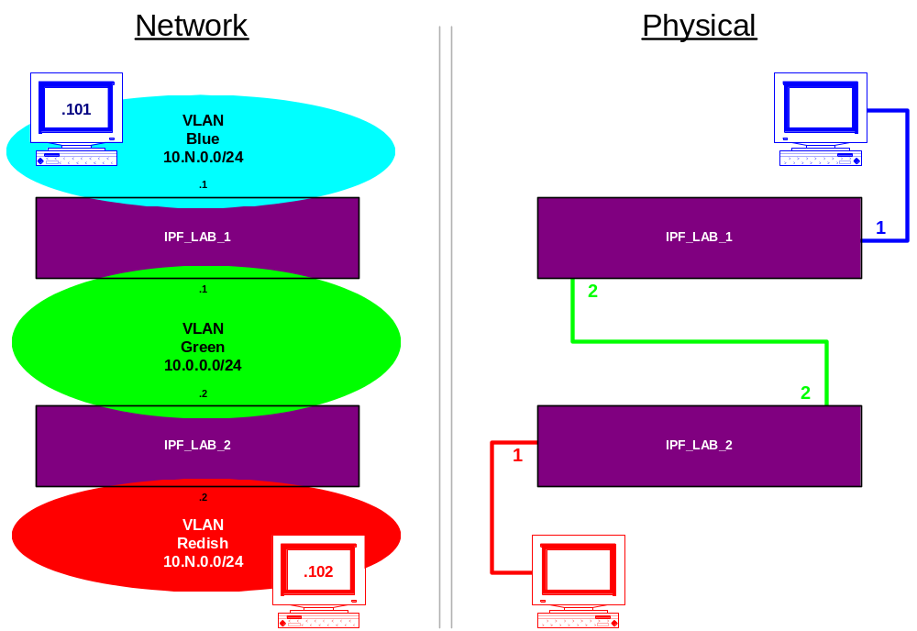
Lab13 – IP Forwarding Configuration
Notes:
The Network topology for Switch1 and Switch 2 is shown above for Lab13 - IP Forwarding Configuration exercise . Use the IP address convention for each of the switch you are configuring as follows:
10.N.0.0/24 where N = Switch Number
Name your switch to match the diagram.

Slide 37
Summary
Describe Layer-3 Operations and differentiate between IP Forwarding and Routing Function
Discuss ExtremeWare Supported IP features
Define RIF, IP Route Table and IPFDB
Describe how to populate entries in the IPFDB and IP Route Table
Learn how to configure IP Unicast Routing
Perform Lab Exercise

Slide 38
This Page is left intentionally blank.

